Slide 1
Hjertets Anatomi, Pumpe og Elektriske egenskaber
sec 5.4-5.6 (p. 516 - 536)
20-11-2024

Slide 2
Agenda
Hjertets anatomi
Hjertet mekaniske egenskaber
Myocytters elektriske egenskaber
Hjertets elektriske egenskaber

Slide 3
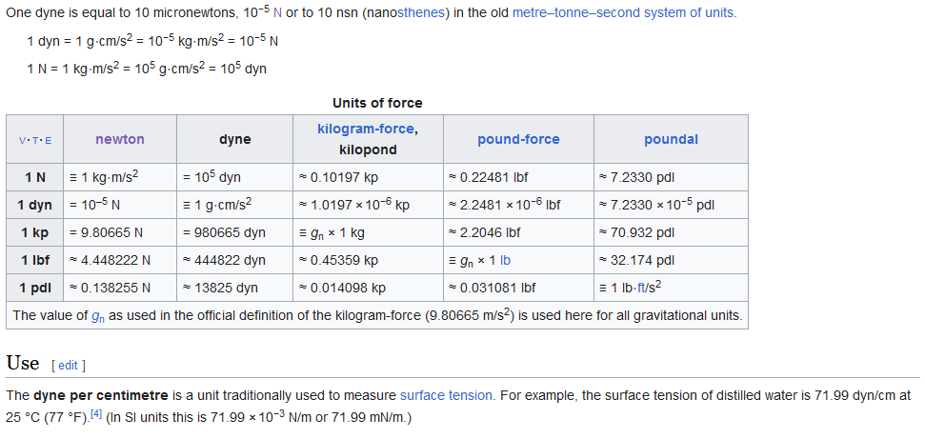
Cheatsheet - dyne

Slide 4
Agenda
Recap
Hjertets anatomi
Hjertet mekaniske egenskaber
myocytters elektriske egenskaber
Hjertets elektriske egenskaber

Slide 5
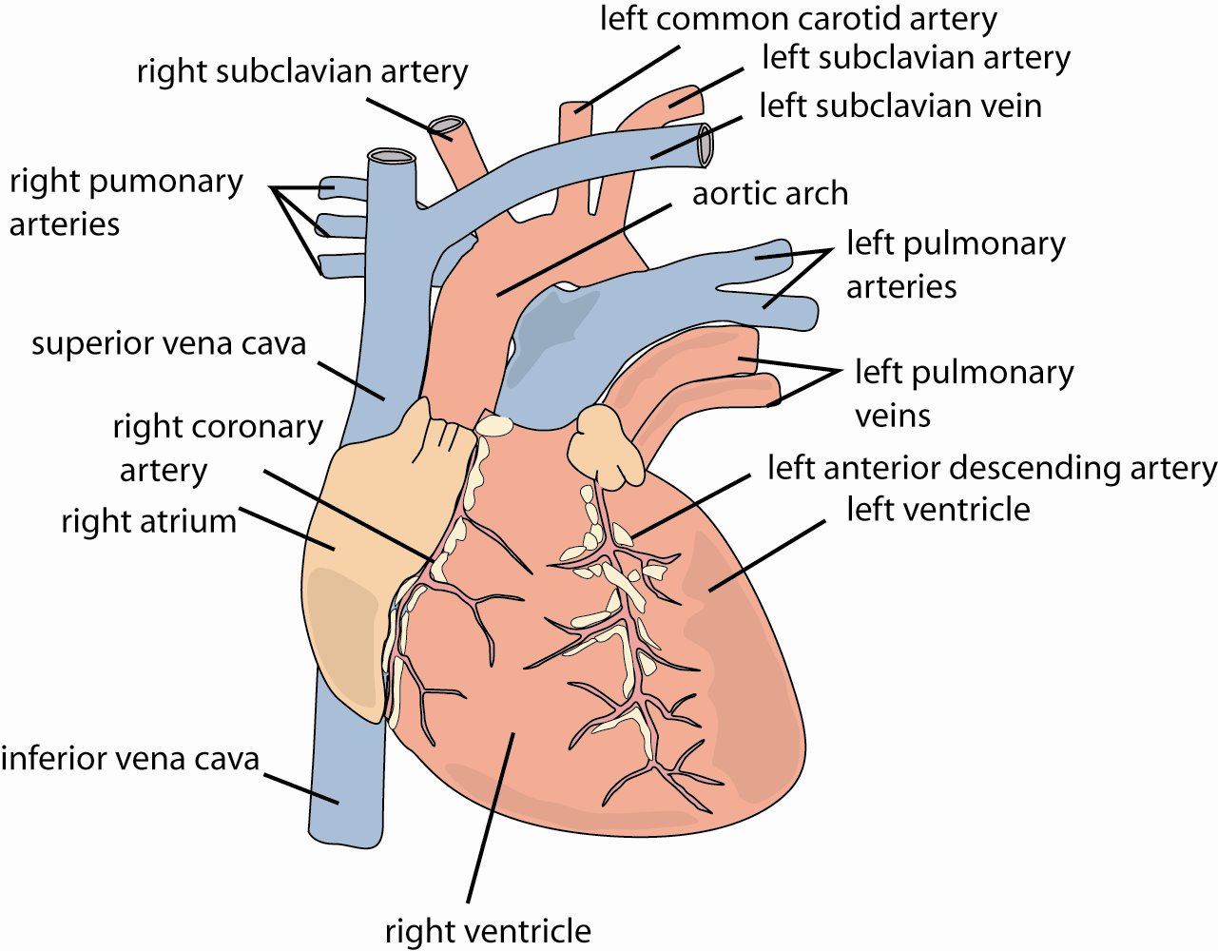
Surface Anatomy – Blood Supply
Surface anatomy
RCA, LAD, Cx
Right, left atria
Auricles
Aorta, aortic arch
pulmonary artery
Superior and Inferior Vena Cava
Pulmonary veins
Notes:
LAD ilt til Anterior Ventre side
RCA ilt til Højre side
Cx Circumflex fra Main Left Coronary Branch, Og leverer blod til bagerste del af hjertet.

Slide 6
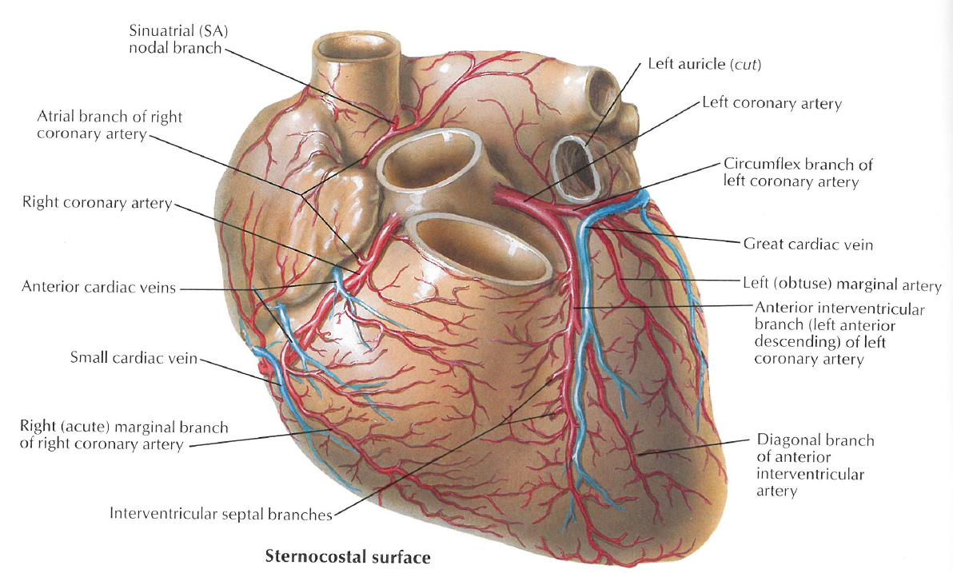
Anterior Surface
Auricles are blind pasages in atria
Notes:
Auricles er blindtarme fra atrierne

Slide 7
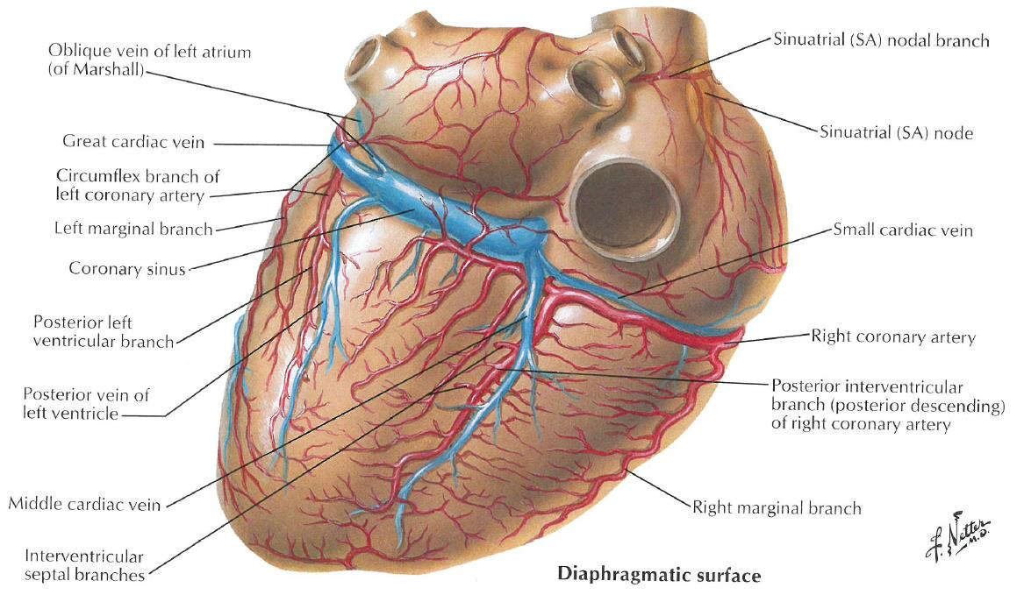
Posterior Blood Supply (from PDA 70%)
PDA from RCA in 70% of people
Right Dominant
For left dominant a Heart Attack from a RCA blockage will do less damage
Notes:
PDA: Posterior Desending Artery
This is about where the blood vessels are!

Slide 8
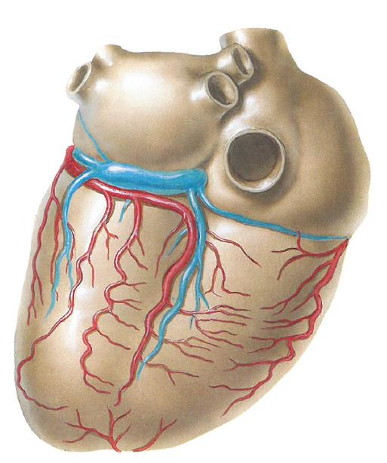
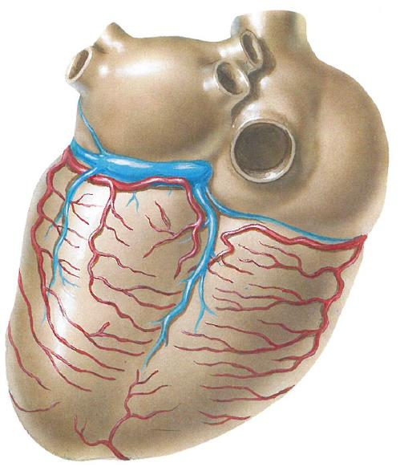
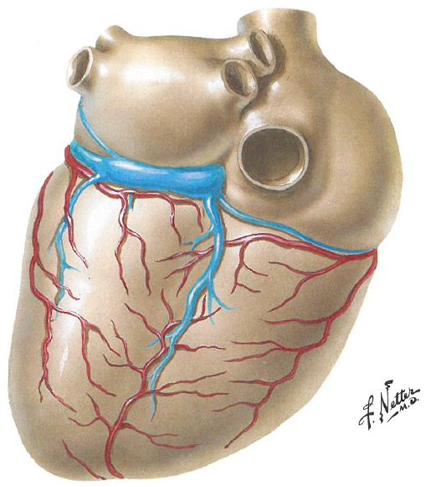
Posterior Blood Supply
Circumflex (20%) Small branches (RC-Cx) (≈5%) LAD (around apex) (≈5%)

Slide 9
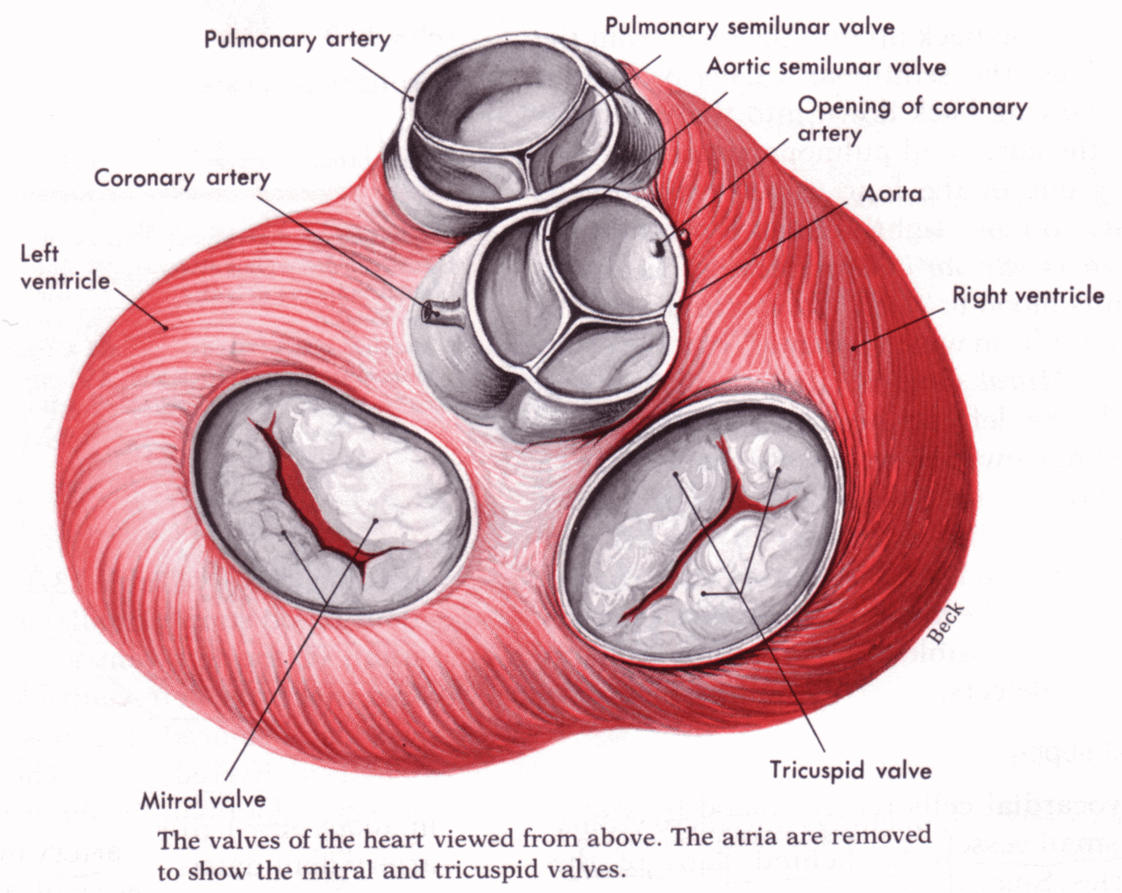
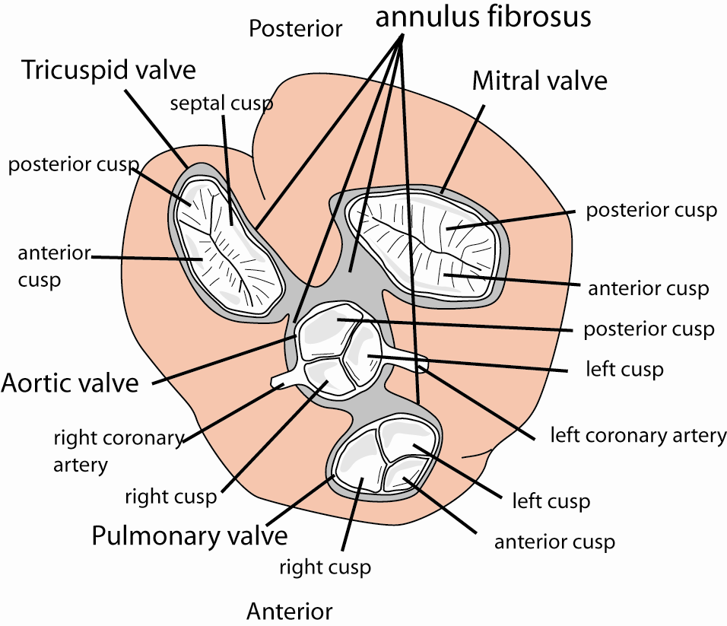
Valve
View from the top, with the atria disected away
Valves lie nearly co-planar in the annulus fibrosus
Mitral Valve: 2 cusps (left side)
Tricuspid Valve: 3 cusps (right side)
Pulm. Valves: 3 cusps
Notes:
Valve = klappe

Slide 10
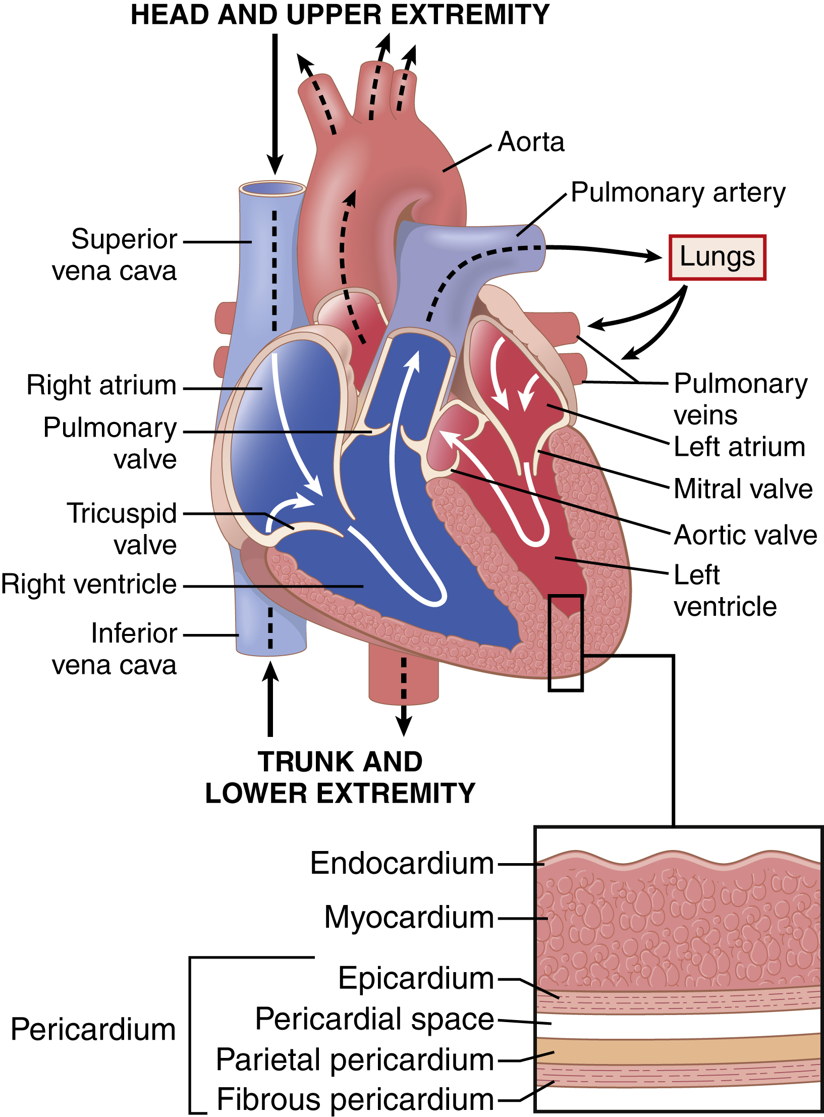
Cross-Sectional Anatomy - The myocardial Wall
Pericardium
Membrane
Pericadial space
Myocardium
Cardiomyocytes
Endocardium
Lumen
Purkinje Fibers

Slide 11
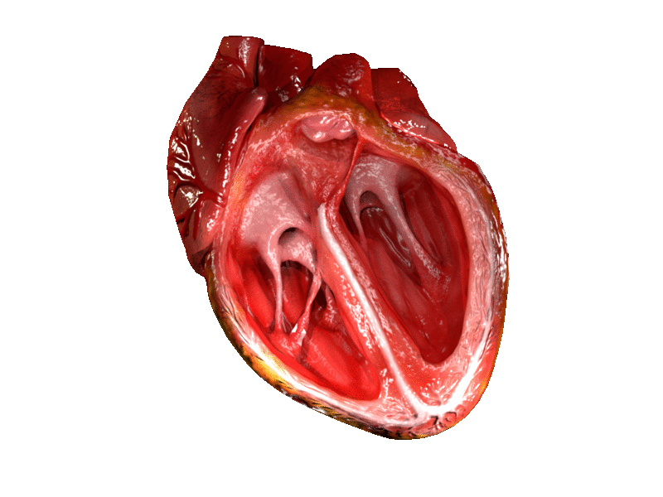
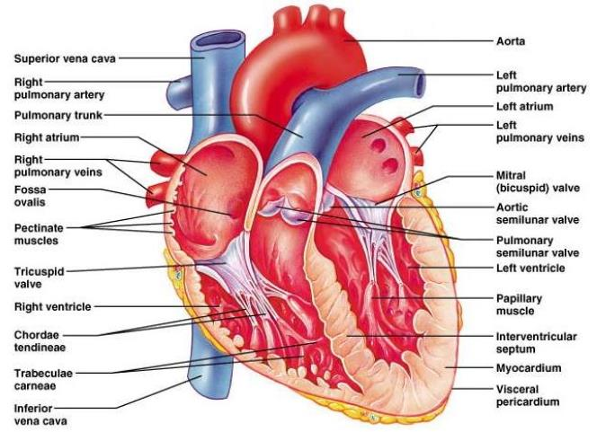
Cross-Sectional Anatomy Valves
Open and Close due to Pressure Gradients
Tricuspid Valve
Pulmonary Valve
Mitral Valve
Aortic Valve

Slide 12
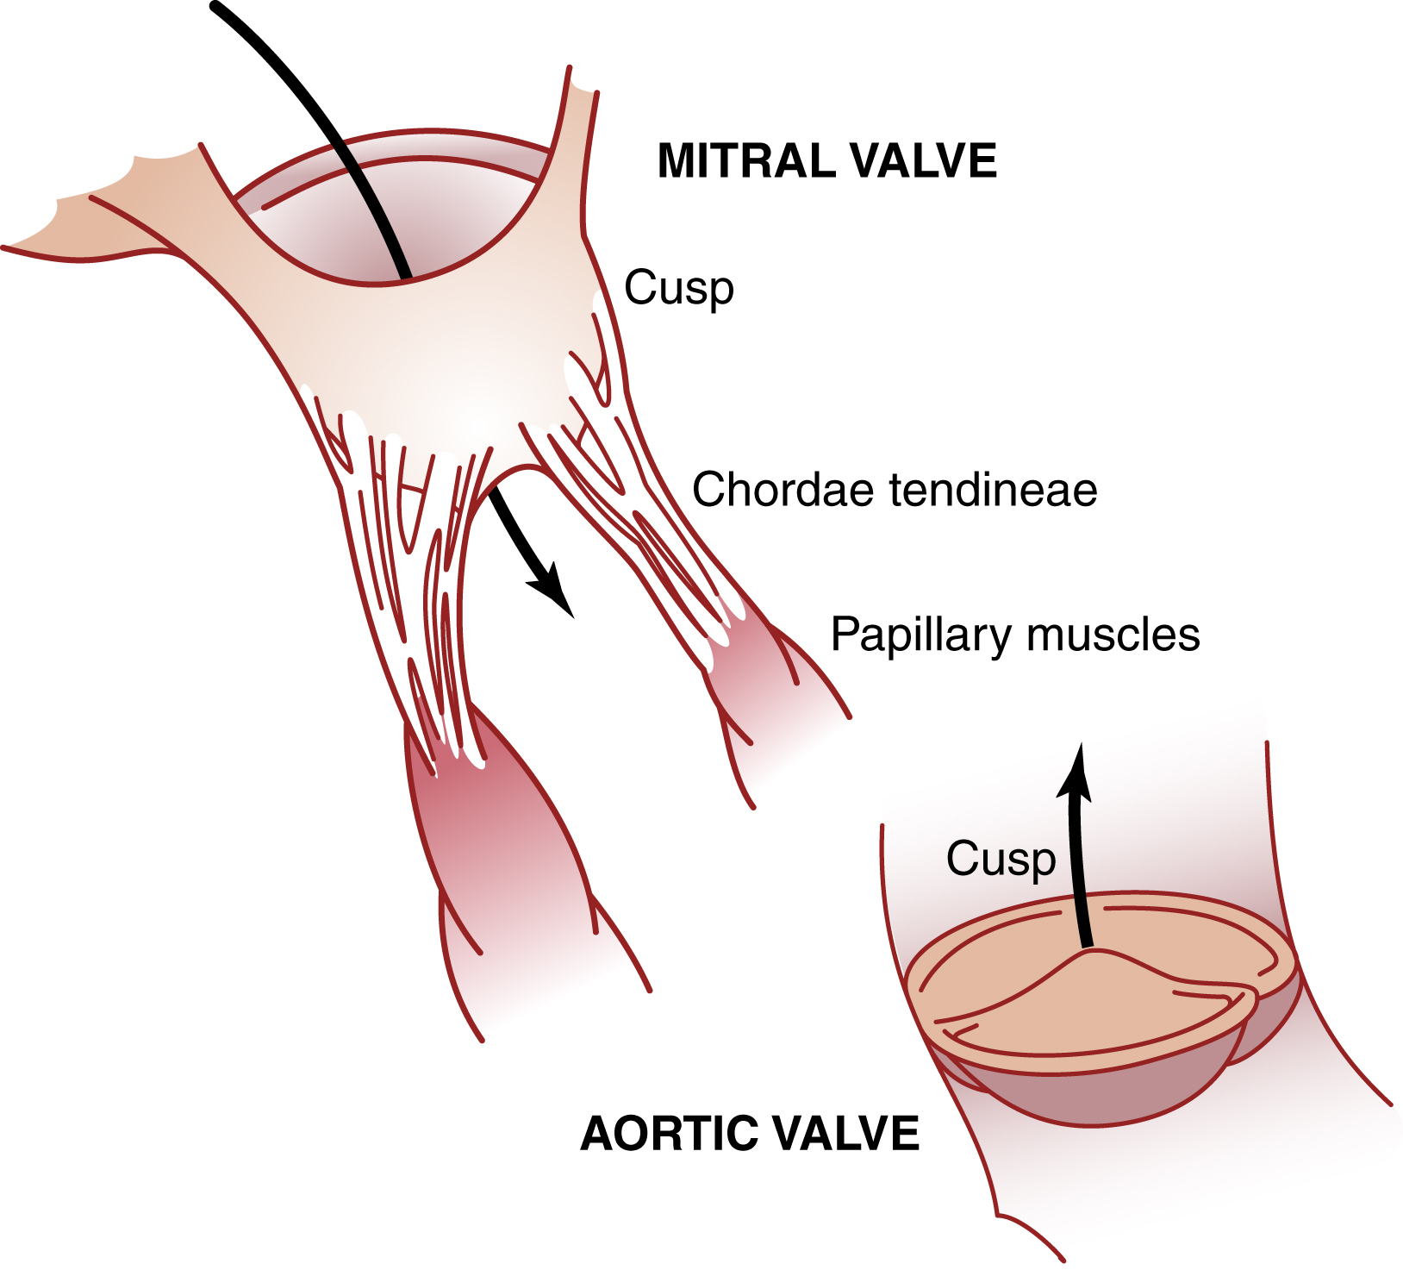
Cross-Sectional AV Valves
A-V Valve
Require almost no pressure difference to close
Cordinae Tendinae
Papilary Muscles
Pull Vanes of vales inwards towards ventricle
Reduce buldge of valves

Slide 13
Cross-Sectional Aortic and Pulmonary Valves
Close due to high pressure gradient between the arteries at end systole and the ventricles
No papilary muscles
Strong and pliable

Slide 14
Agenda
Hjertets anatomi
Hjertet mekaniske egenskaber
myocytters elektriske egenskaber
Hjertets elektriske egenskaber

Slide 15
Blood Flow
Left Side
Pulmonary Veins
LA
Mitral Valve
LV
Aortic Valve
Aorta
Right Side
Vena Cava
RA
Tricuspid Valve
RV
Pulmonary Valve
Pulmonary Artery

Slide 16
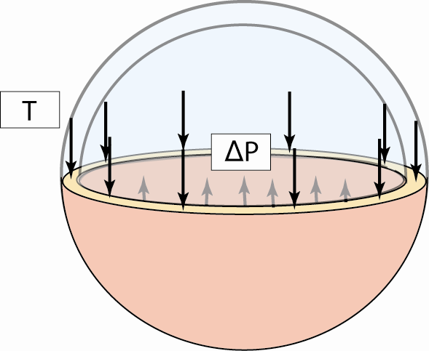
The Heart
4 chambers
Generally, is described as a Left and Right Heart
In series, two by two, and with valves in between
Contractions lead to wall tension
Leads to pressure
Drives flow
Notes:
Tryk er lig med Kraft over et areal ($P [\frac{N}{m^{2}}]$)
T : Tension [N/m]
$σ$: Wall stress [N/m^2]

Slide 17
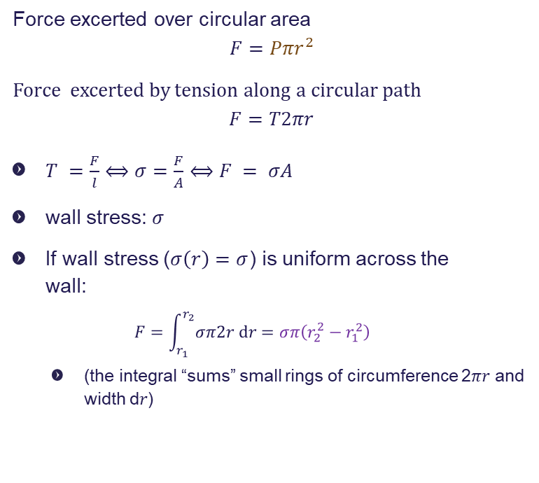
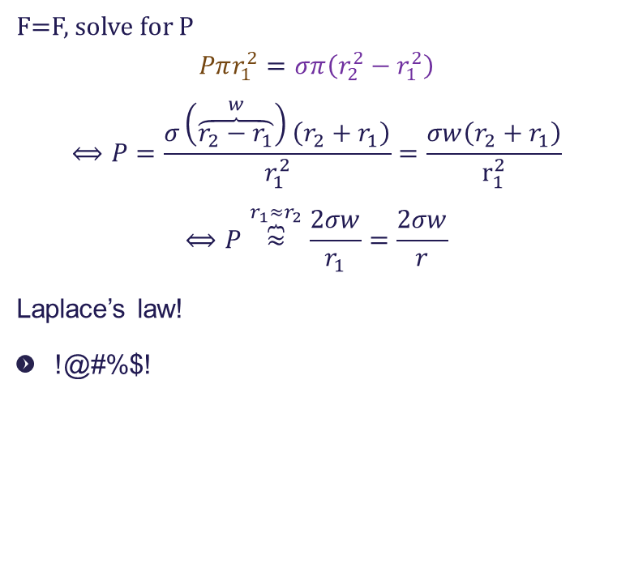
Model the heart chamber as sphere
Force excerted over circular area
$$F=Pπr^{2}$$
Force excerted by tension along a circular path
$$F=T2πr$$
$T =\frac{F}{l}⟺σ=\frac{F}{A}⟺F = σA$
wall stress: $σ$
If wall stress ($σ\left(r\right)=σ$) is uniform across the wall:
$$F=\int_{r_{1}}^{r_{2}}{σπ2r dr}=σπ\left(r_{2}^{2}−r_{1}^{2}\right)$$
(the integral “sums” small rings of circumference 2𝜋𝑟 and width d𝑟)
F=F, solve for P
$$Pπr_{1}^{2}=σπ\left(r_{2}^{2}−r_{1}^{2}\right)$$
$$⟺P=\frac{σ\left(\overset{w}{\overbrace{r_{2}−r_{1}}}\right)\left(r_{2}+r_{1}\right)}{r_{1}^{2}}=\frac{σw\left(r_{2}+r_{1}\right)}{r_{1}^{2}}$$
$$⟺P\overset{r_{1}≈r_{2}}{\overbrace{≈}}\frac{2σw}{r_{1}}=\frac{2σw}{r}$$
Laplace’s law!
!@#%$!
Notes:
T : N/m
Pa=N/m2
Tryk over hele overfladen (F) =

Slide 18
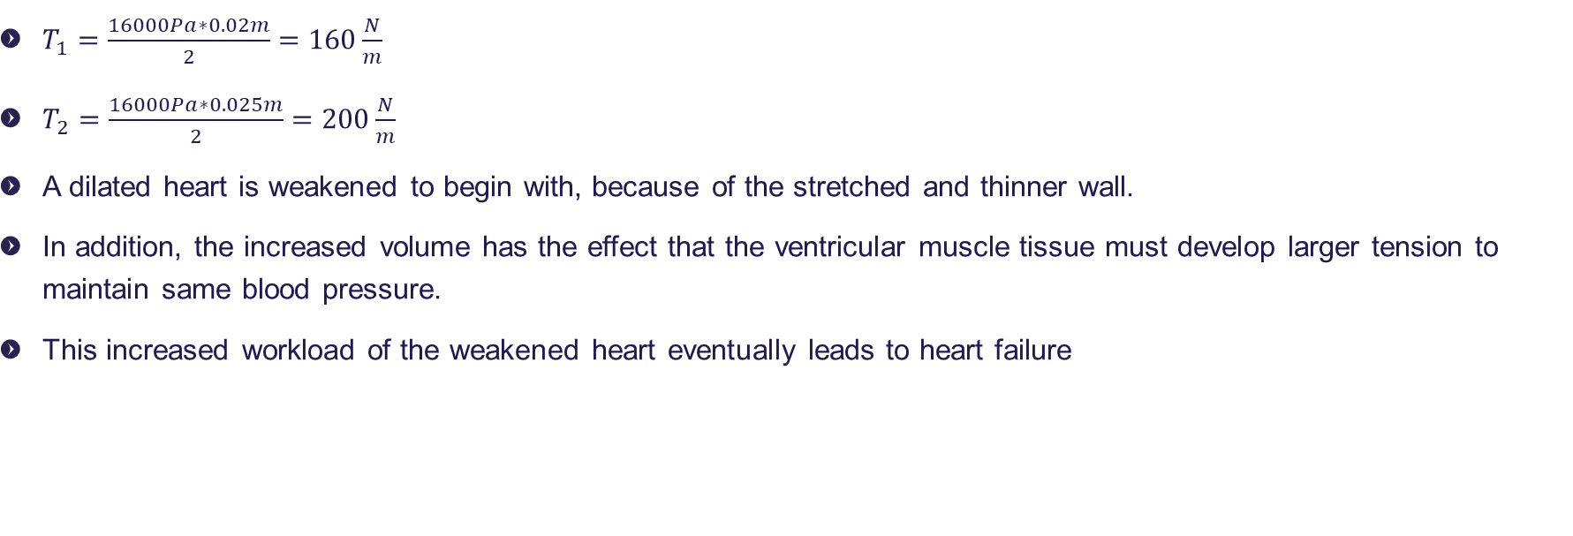
Solution
$T_{1}=\frac{16000Pa∗0.02m}{2}=160\frac{N}{m}$
$T_{2}=\frac{16000Pa∗0.025m}{2}=200\frac{N}{m}$
A dilated heart is weakened to begin with, because of the stretched and thinner wall.
In addition, the increased volume has the effect that the ventricular muscle tissue must develop larger tension to maintain same blood pressure.
This increased workload of the weakened heart eventually leads to heart failure

Slide 19
Agenda
Hjertets anatomi
Hjertet mekaniske egenskaber
Myocytters elektriske egenskaber
Hjertets elektriske egenskaber

Slide 20
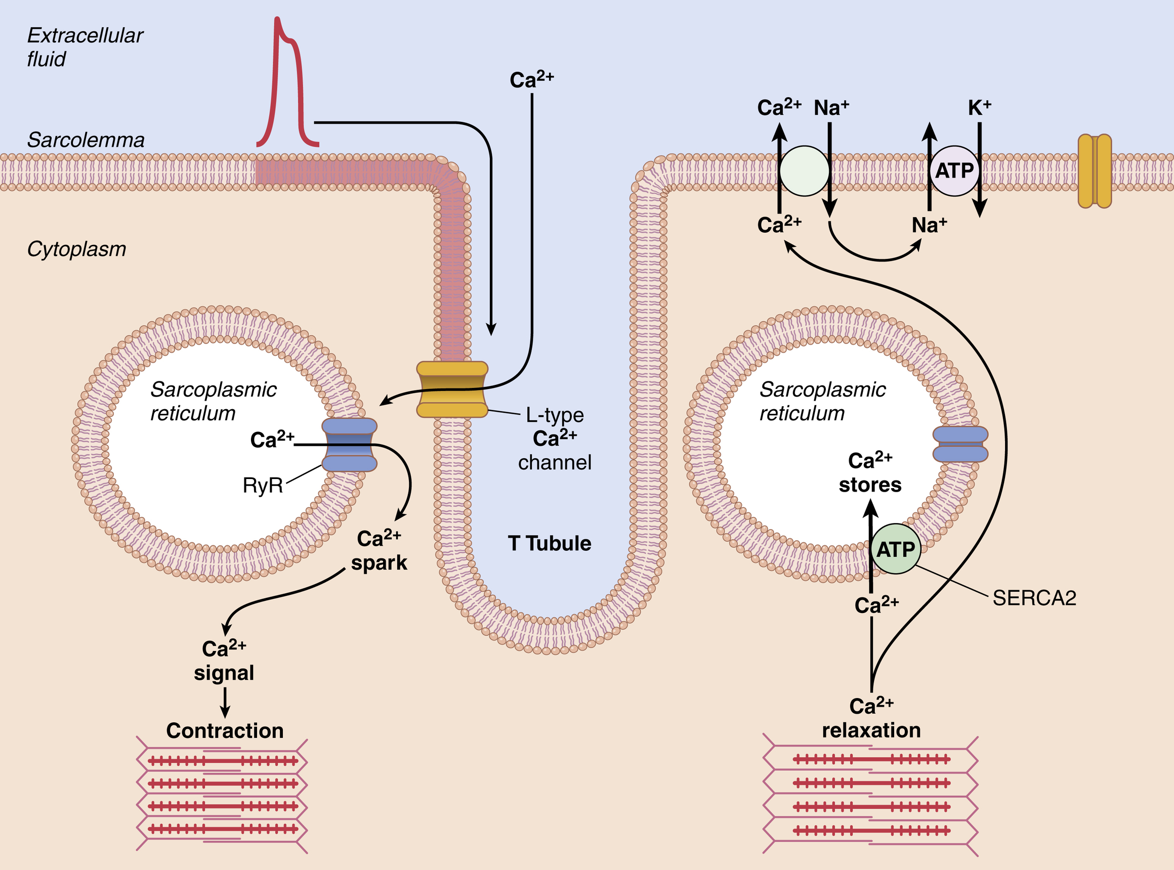
Conductive Pathways Skeletal vs Cardiac Muscle Fibers
Skeletal muscle Fibers
Nervous stimulation
Recruitment – the progressive involvement of more motor units and so more muscle fibers
Frequency summation – repetitive stimulation of motor units that increase the force
Cardiac muscle Fibers:
100% recruitment
One contraction per heartbeat

Slide 21
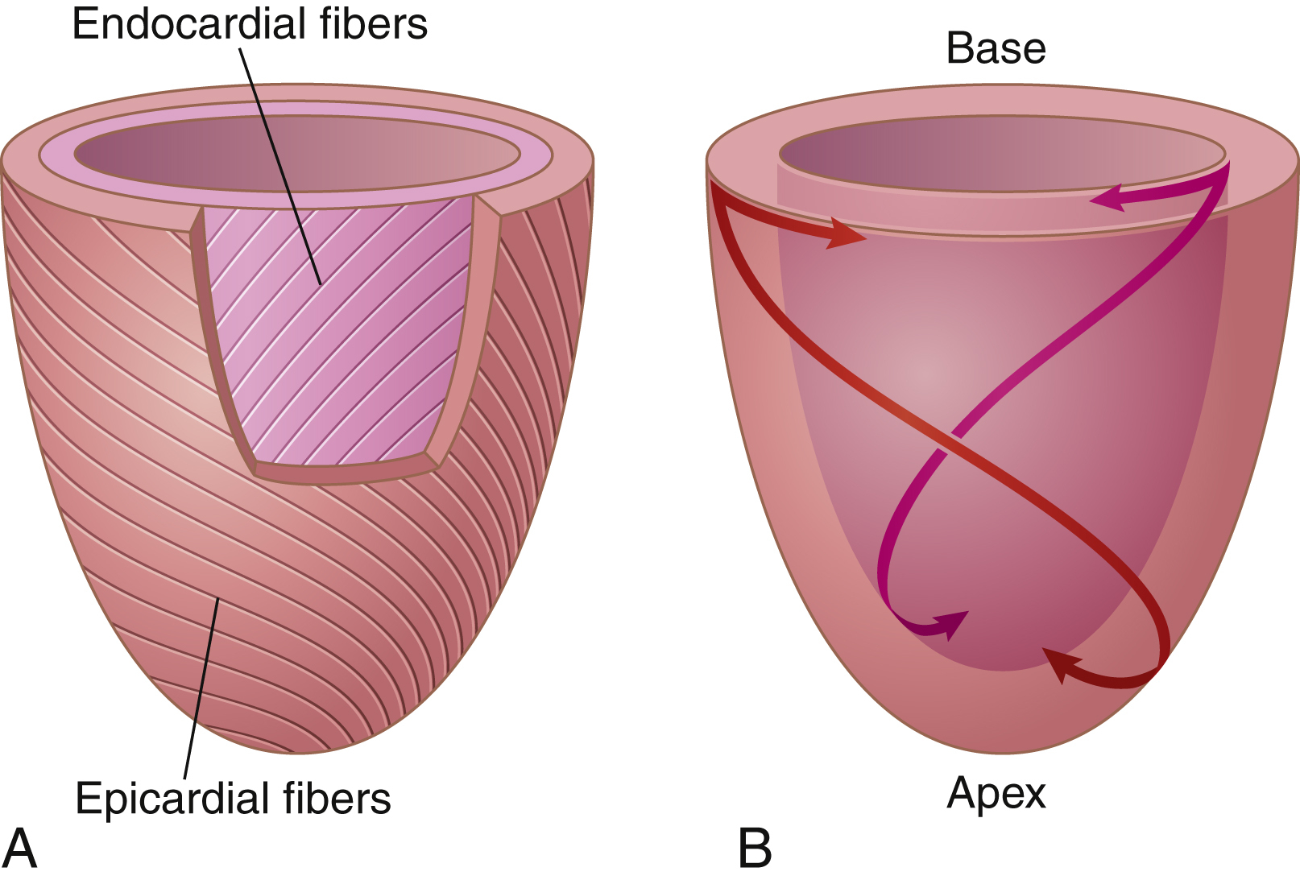
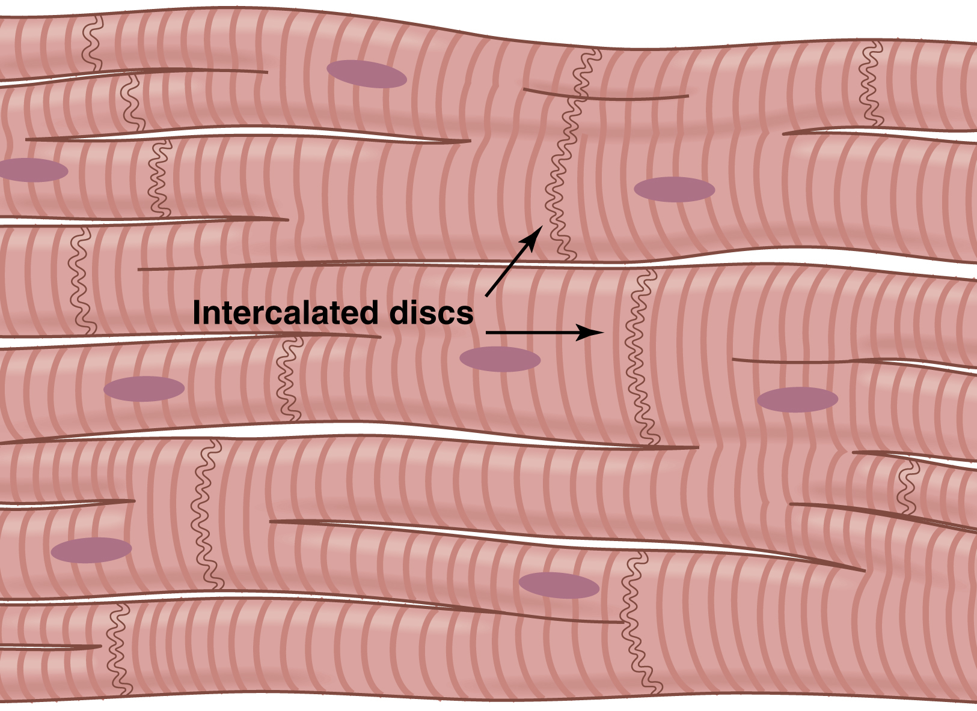
Conductive Pathways Cardiomyocytes
Gap Junctions
The subepicardial muscle fibers are wrapped in a left-handed helix and subendocardial fibers are arranged in a right-handed helix.

Slide 22
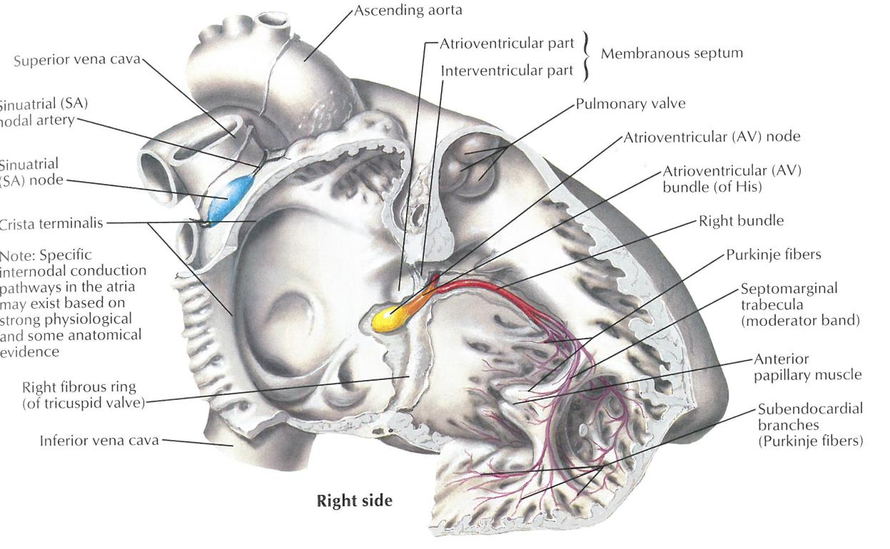
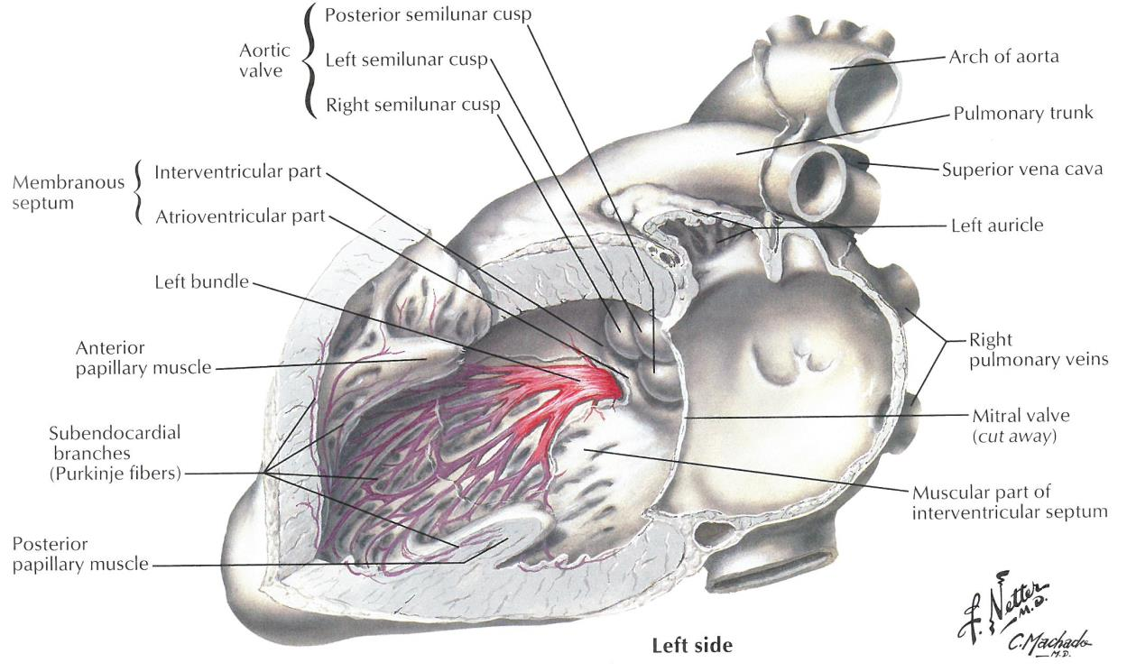
Conductive Pathways
SA Node (Near Superior Vena Cava)
Pacemaker Cell
Internodal Pathways to AV Node
Branch to left atrium (Backmann’s Bundle)
AV Node + Pacemaker
Bundle of His
Left and Right Bundle Branch
Purkinje Fibers
Myocardium

Slide 23
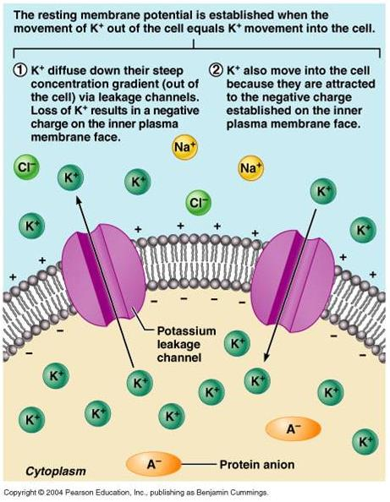
Cardiac Action Potentials
Conditions relevant for ion distribution:
Large negative ions that cannot pass the membrane
Na-K ATPase that (tries to) maintain(s) a concentration gradient
Ion-selective leakage channels

Slide 24
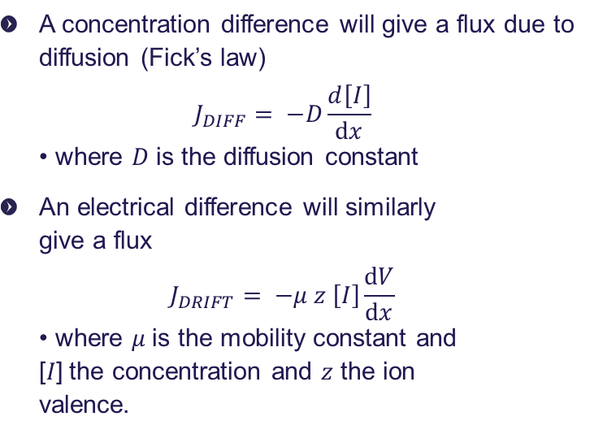
Cardiac Action Potential
Diffusion er concentration drevet
Drift er ladnings drevet
A concentration difference will give a flux due to diffusion (Fick’s law) $J_{DIFF}= −D\frac{d\left[I\right]}{dx}$ • where 𝐷 is the diffusion constant
An electrical difference will similarly give a flux $J_{DRIFT}= −μ z \left[I\right]\frac{dV}{dx}$ • where 𝜇 is the mobility constant and [𝐼] the concentration and 𝑧 the ion valence.

Slide 25
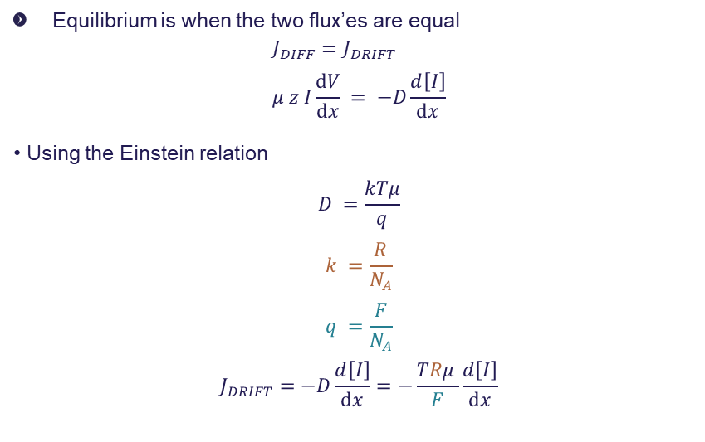
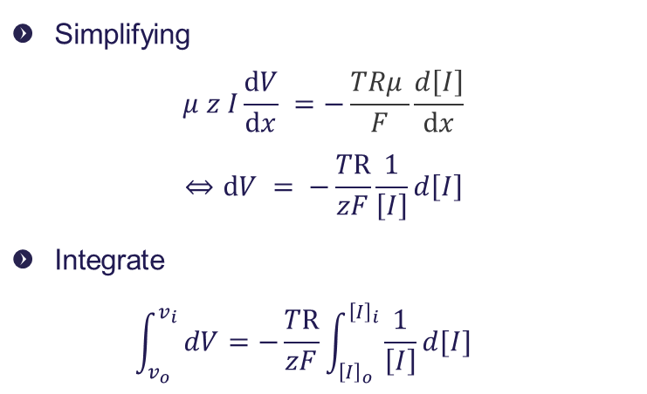
Cardiac Action Potential
flux due to diffusion (Fick’s law) Electric gradient flux
D : Diffusions Constant-1
N_A: Avogardro Number = 6.022 × 1023 particles mol
F: Faradays constant
Equilibrium is when the two flux’es are equal
$$J_{DIFF}=J_{DRIFT} \\ μ z I\frac{dV}{dx} = −D\frac{d\left[I\right]}{dx}$$ • Using the Einstein relation $$D =\frac{kTμ}{q}$$
$$k =\frac{R}{N_{A}} \\ q =\frac{F}{N_{A}}$$
$$J_{DRIFT}=−D\frac{d\left[I\right]}{dx}=−\frac{TRμ }{F}\frac{d\left[I\right]}{dx}$$
Simplifying $μ z I\frac{dV}{dx} =−\frac{TRμ }{F}\frac{d\left[I\right]}{dx}$
$$⇔dV = −\frac{TR}{zF}\frac{1}{\left[I\right]}d\left[I\right]$$
Integrate $\int_{v_{o}}^{v_{i}}{ dV}=−\frac{TR}{zF}\int_{{\left[I\right]}_{o}}^{{\left[I\right]}_{i}}{\frac{1}{\left[I\right]}d[I]}$

Slide 26
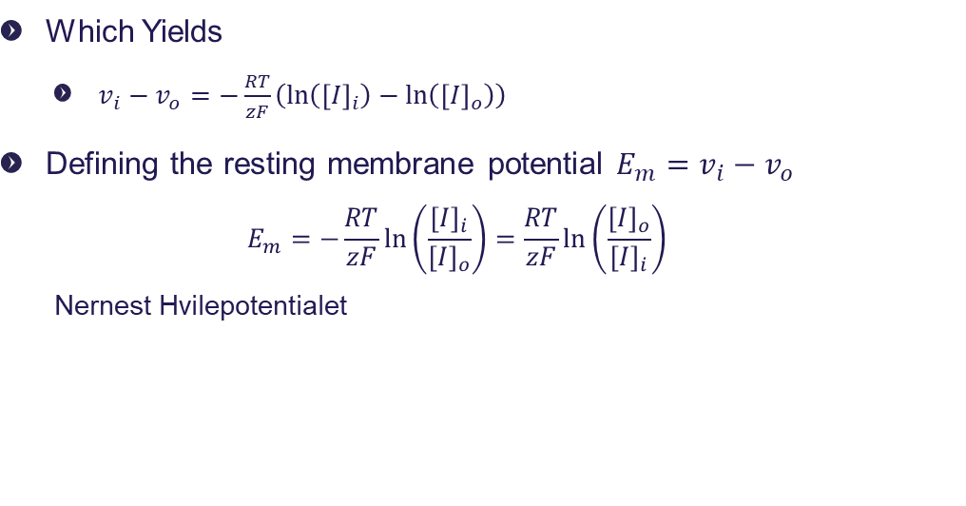
Cardiac Action Potential
Which Yields
$v_{i}−v_{o}=−\frac{RT}{zF}\left(\ln\left({\left[I\right]}_{i}\right)−\ln\left({\left[I\right]}_{o}\right)\right)$
Defining the resting membrane potential $E_{m}=v_{i}−v_{o}$
$$E_{m}=−\frac{RT}{zF}\ln\left(\frac{{\left[I\right]}_{i}}{{\left[I\right]}_{o}}\right)=\frac{RT}{zF}\ln\left(\frac{{\left[I\right]}_{o}}{{\left[I\right]}_{i}}\right)$$
Nernest Hvilepotentialet
This is the equilibrium potential across a semipermeable membrane, given the two concentrations

Slide 27
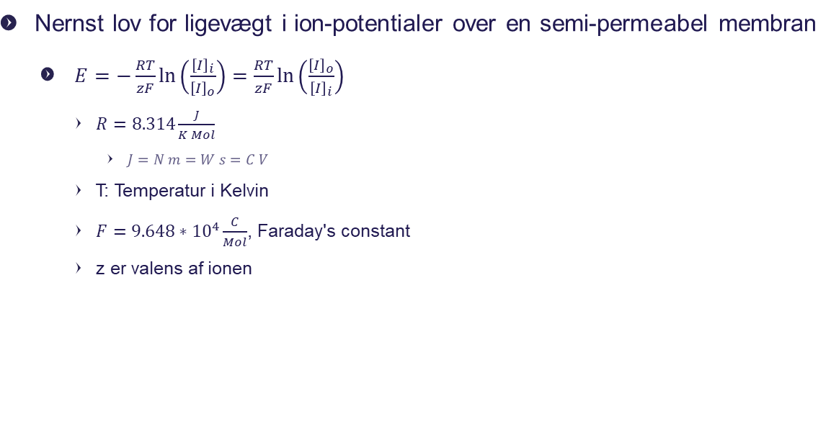
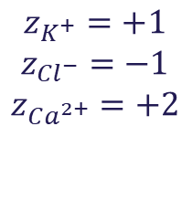
Nernest Diffusion Ligevægts Potentiale
Valence z for Na+ er 1+
Ca2+ er 2
Nernst lov for ligevægt i ion-potentialer over en semi-permeabel membran
$E=−\frac{RT}{zF}\ln\left(\frac{{\left[I\right]}_{i}}{{\left[I\right]}_{o}}\right)=\frac{RT}{zF}\ln\left(\frac{{\left[I\right]}_{o}}{{\left[I\right]}_{i}}\right)$
$R=8.314\frac{J}{K Mol}$
$J=N m=W s=C V$
T: Temperatur i Kelvin
$F=9.648∗{10}^{4}\frac{C}{Mol}$, Faraday's constant
z er valens af ionen
$$z_{K^{+}}=+1$$
$$z_{{Cl}^{−}}=−1$$
$$z_{Ca^{2+}}=+2$$

Slide 28
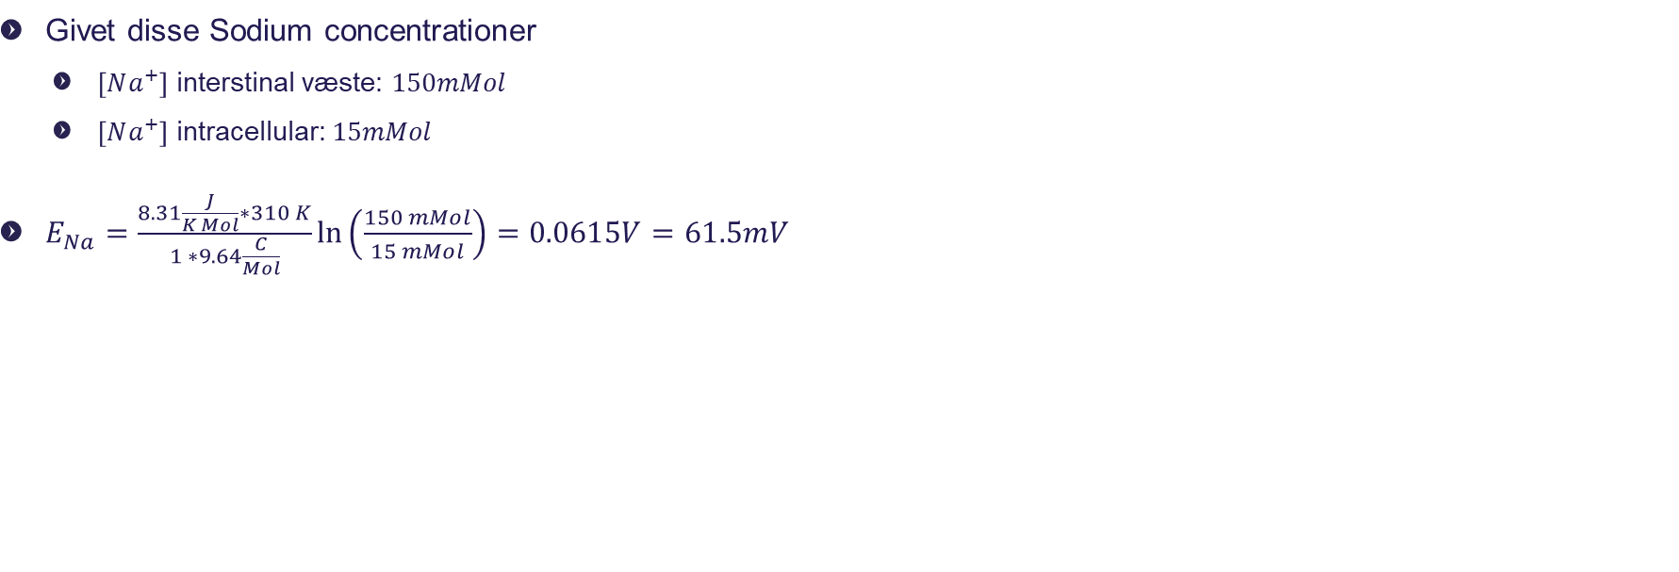
Øvelse – beregn Nernst ligevægts potentiale
Givet disse Sodium concentrationer
$\left[Na^{+}\right]$ interstinal væste: $150mMol$
$\left[Na^{+}\right]$ intracellular: $15mMol$
$E_{Na}=\frac{8.31\frac{J}{K Mol}∗310 K}{1 ∗9.64\frac{C}{Mol}}\ln\left(\frac{150 mMol}{15 mMol}\right)=0.0615V=61.5mV$
# python script
import math
z = 1
T = 37 + 273
F = 9.648 * 10**4
R = 8.31
Na_i = 15.0 * 10**-3
Na_o = 150.0 * 10**-3
E_Na = R * T / z / F * math.log(Na_o / Na_i)
print(f"E_Na = {E_Na*1000.0:.1f} mV")
>>> E_Na = 61.5 mV

Slide 29
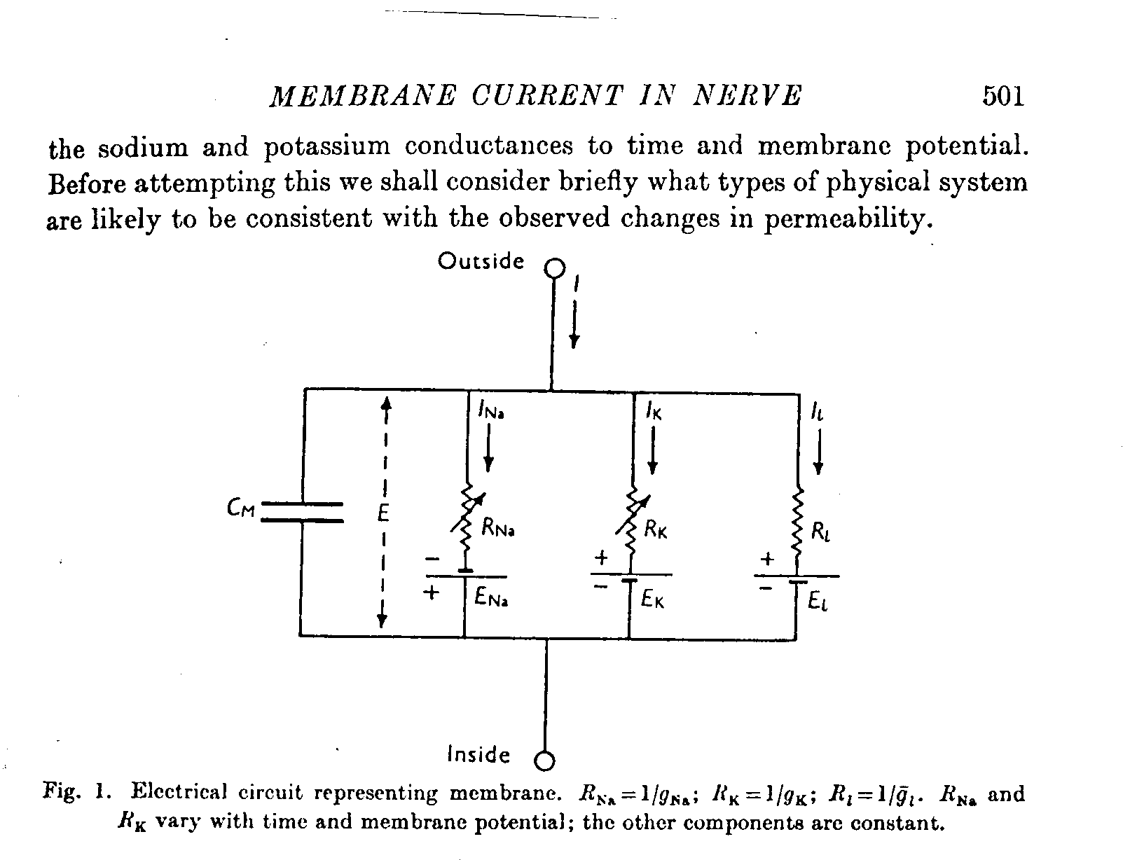
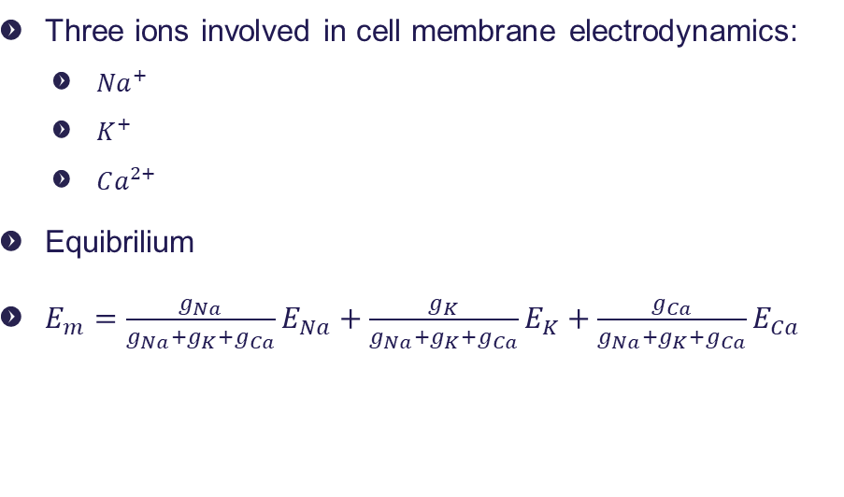
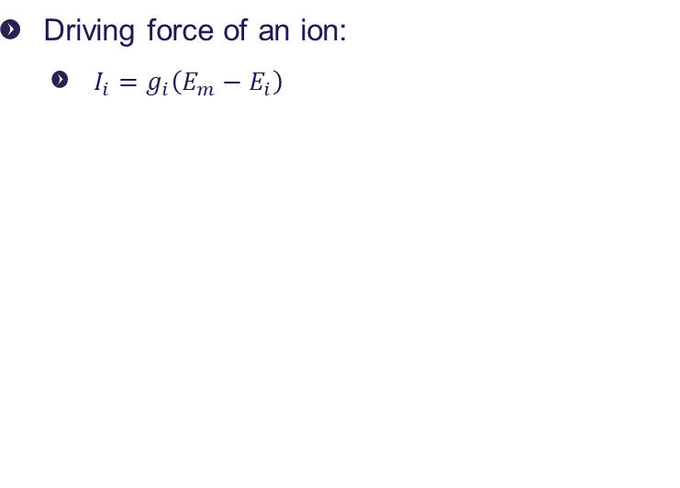
Cardiac Action Potential
Three ions involved in cell membrane electrodynamics:
${Na}^{+}$
$K^{+}$
$Ca^{2+}$
Equibrilium
$E_{m}=\frac{g_{Na}}{g_{Na}+g_{K}+g_{Ca}}E_{Na}+\frac{g_{K}}{g_{Na}+g_{K}+g_{Ca}}E_{K}+\frac{g_{Ca}}{g_{Na}+g_{K}+g_{Ca}}E_{Ca}$
Driving force of an ion:
$I_{i}=g_{i}\left(E_{m}−E_{i}\right)$
V

Slide 30
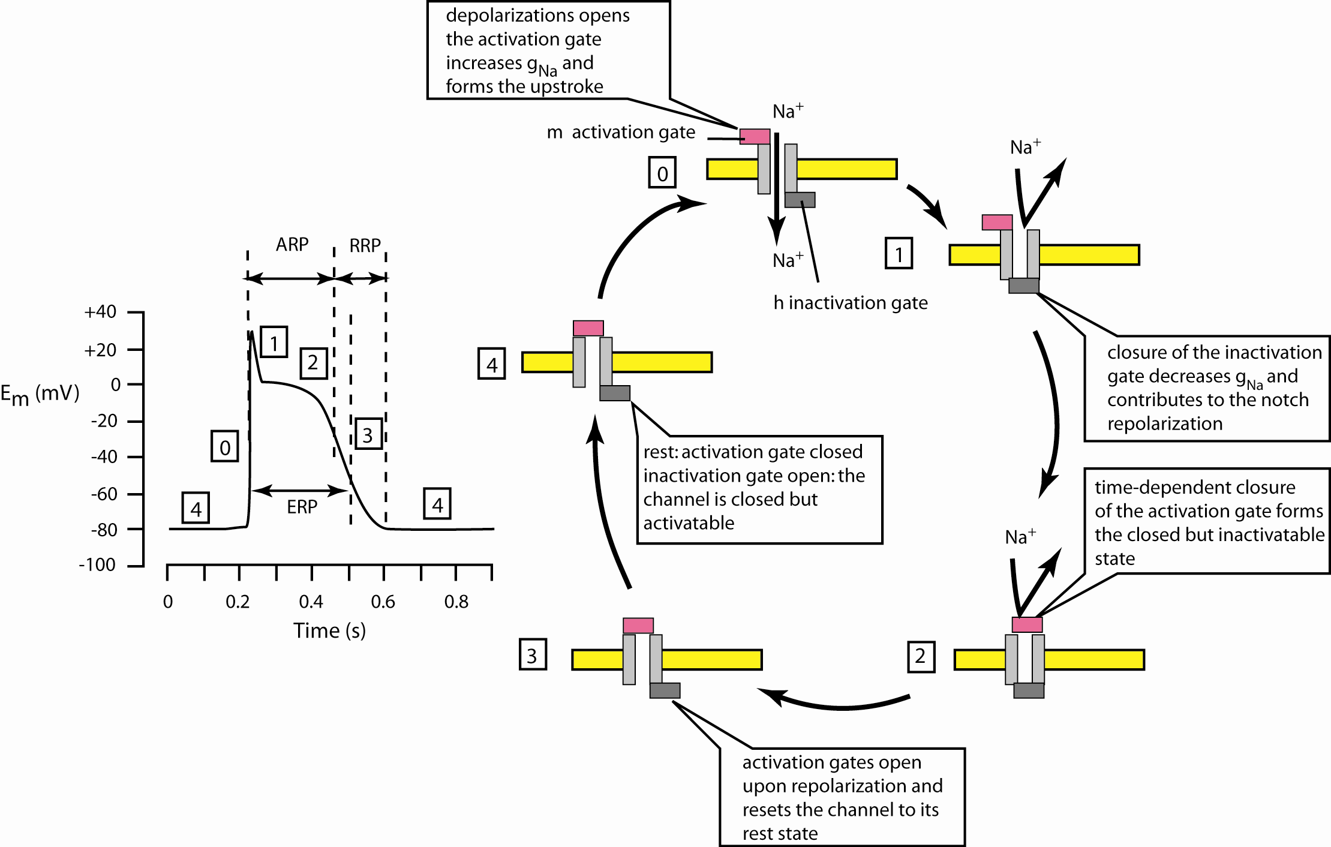
Cardiac Action Potential (Ventricular myocytes)
ERP: Effective Refractory Period
RRP: Relative Refractory Period
ARP: Absolute Refractory Period

Slide 31
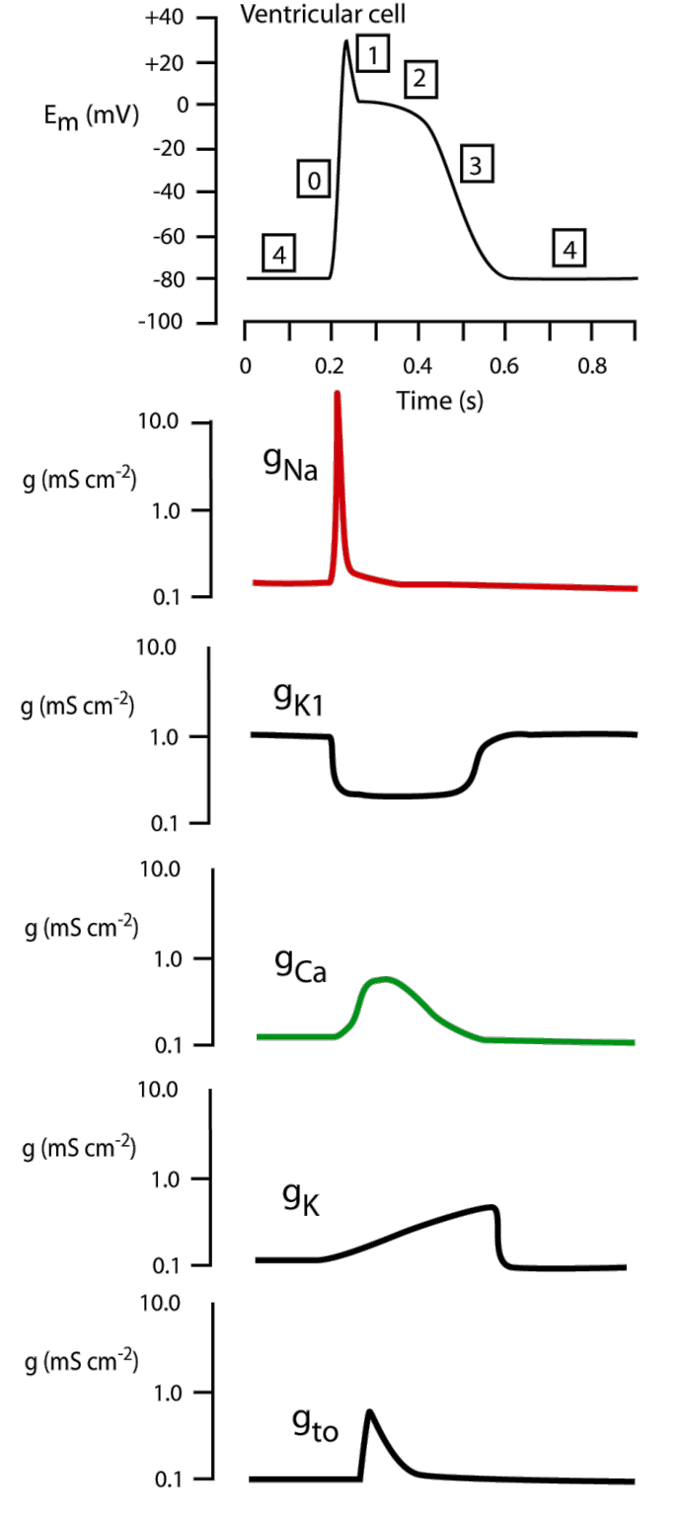
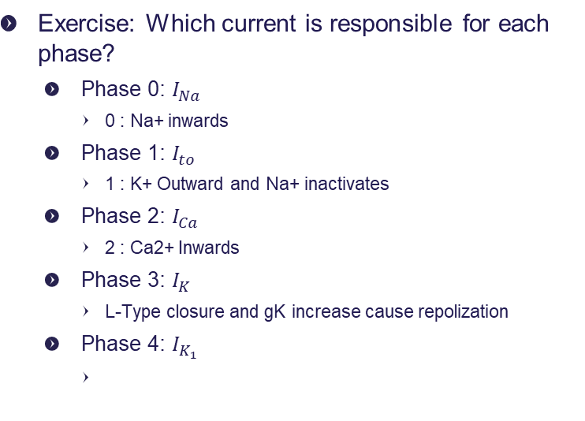
Cardiac Action Potential
Exercise: Which current is responsible for each phase?
Phase 0: $I_{Na}$
0 : Na+ inwards
Phase 1: $I_{to}$
1 : K+ Outward and Na+ inactivates
Phase 2: $I_{Ca}$
2 : Ca2+ Inwards
Phase 3: $I_{K}$
L-Type closure and gK increase cause repolization
Phase 4: $I_{K_{1}}$
Notes:
0 : Na+ inwards
1 : K+ Outward and Na+ inactivates
2 : Ca2+ Inwards
3 : L-Type closure and gK increase cause repolization
4 :

Slide 32
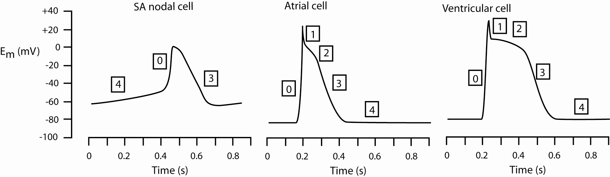
Cardiac Action Potential
Heterogeneous channel expressions
Heterogeneous action potentials
Notes:
dissimilar channel expression : dissimilar action potential
Altså, når vi ikke ser de samem

Slide 33
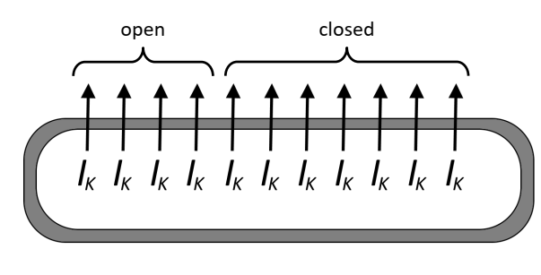
Cardiac Action Potential
Voltage gated ion channels are either open or closed
Single channels act stochastically
Hodgkin-Huxley describe the overall effect on the cell

Slide 34
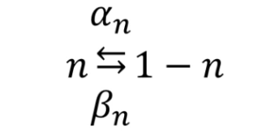
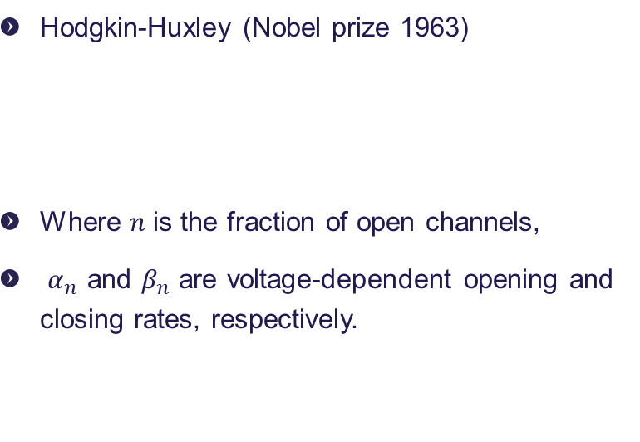
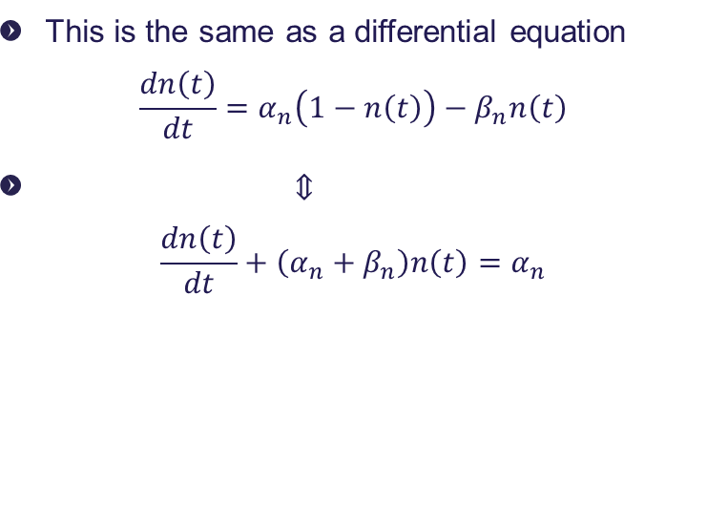
Cardiac Action Potential
Hodgkin-Huxley (Nobel prize 1963)
Where 𝑛 is the fraction of open channels,
$α_{n}$ and $β_{n}$ are voltage-dependent opening and closing rates, respectively.
This is the same as a differential equation $\frac{dn\left(t\right)}{dt}=α_{n}\left(1−n\left(t\right)\right)−β_{n}n\left(t\right)$
⇕ $\frac{dn\left(t\right)}{dt}+\left(α_{n}+β_{n}\right)n\left(t\right)=α_{n}$
Notes:
Når åbnings raten øjes, så vil flere kanaler være åbne, og vise versa.

Slide 35
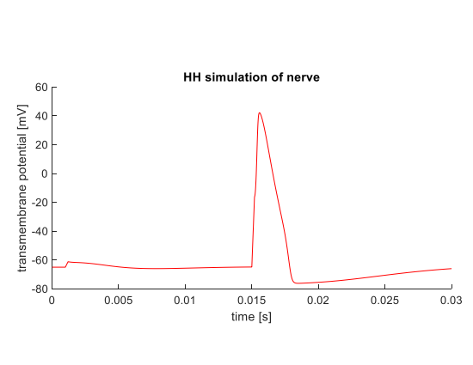
Hogdkin-Huxley in practice
Small stimulus: Voltage-gated channels do not open, Na-K pump (and increased leakage currents) brings nerve fiber back to resting potential.
Large stimulus: Voltage-gated channel open, and fiber depolarizes.

Slide 36
Agenda
Recap
Hjertets anatomi
Hjertet mekaniske egenskaber
Myocytters elektriske egenskaber
Hjertets elektriske egenskaber

Slide 37
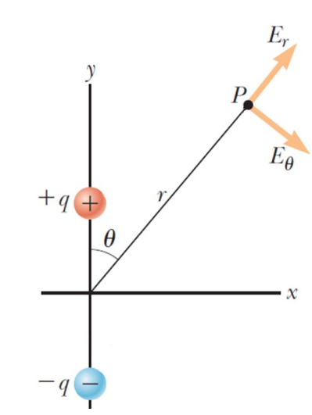
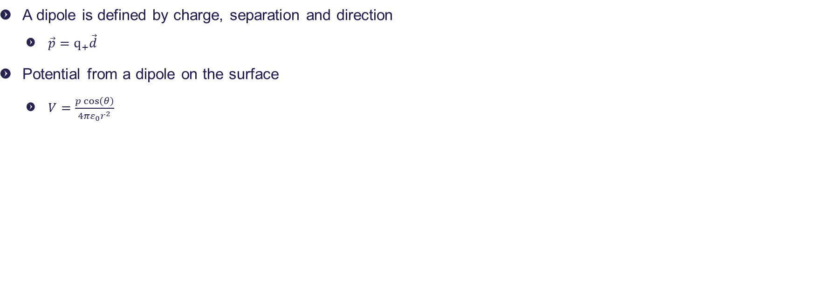
The ECG
A dipole is defined by charge, separation and direction
$\vec{p}=q_{+}\vec{d}$
Potential from a dipole on the surface
$V=\frac{p\cos\left(θ\right)}{4πε_{0}r^{2}}$

Slide 38
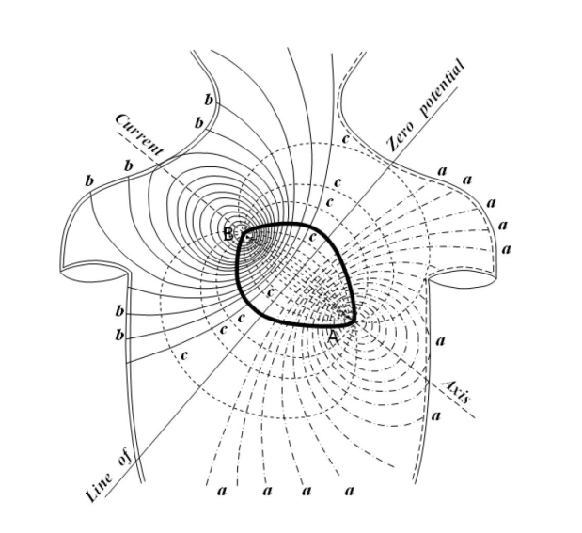
The ECG

Slide 39
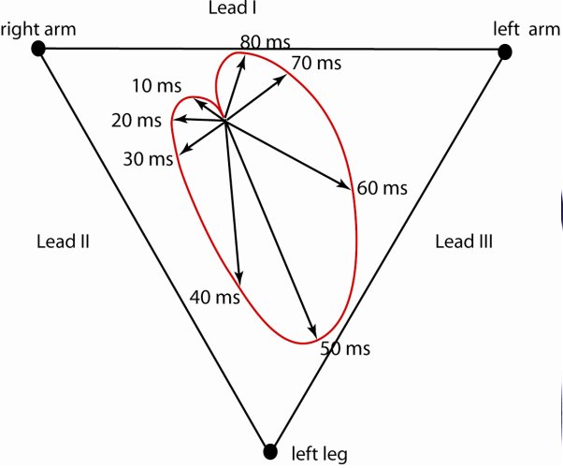
Vector Loop
the “Activation front” generates the ECG deflections

Slide 40
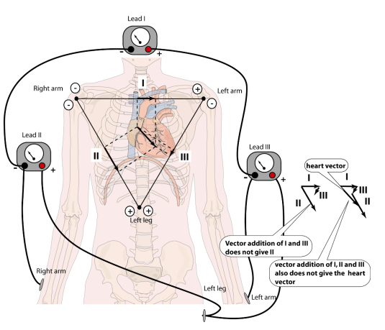
Eindhovens Triangle
Left Arm – Right Arm = Lead 1
Left Leg – Right Arm = Lead 2
Left leg – left arm = Lead 3
II=I+III
Notes:
Left Arm – Right Arm = Lead 1
Left Leg – Right Arm = Lead 2
Left leg – left arm = Lead 3

Slide 41
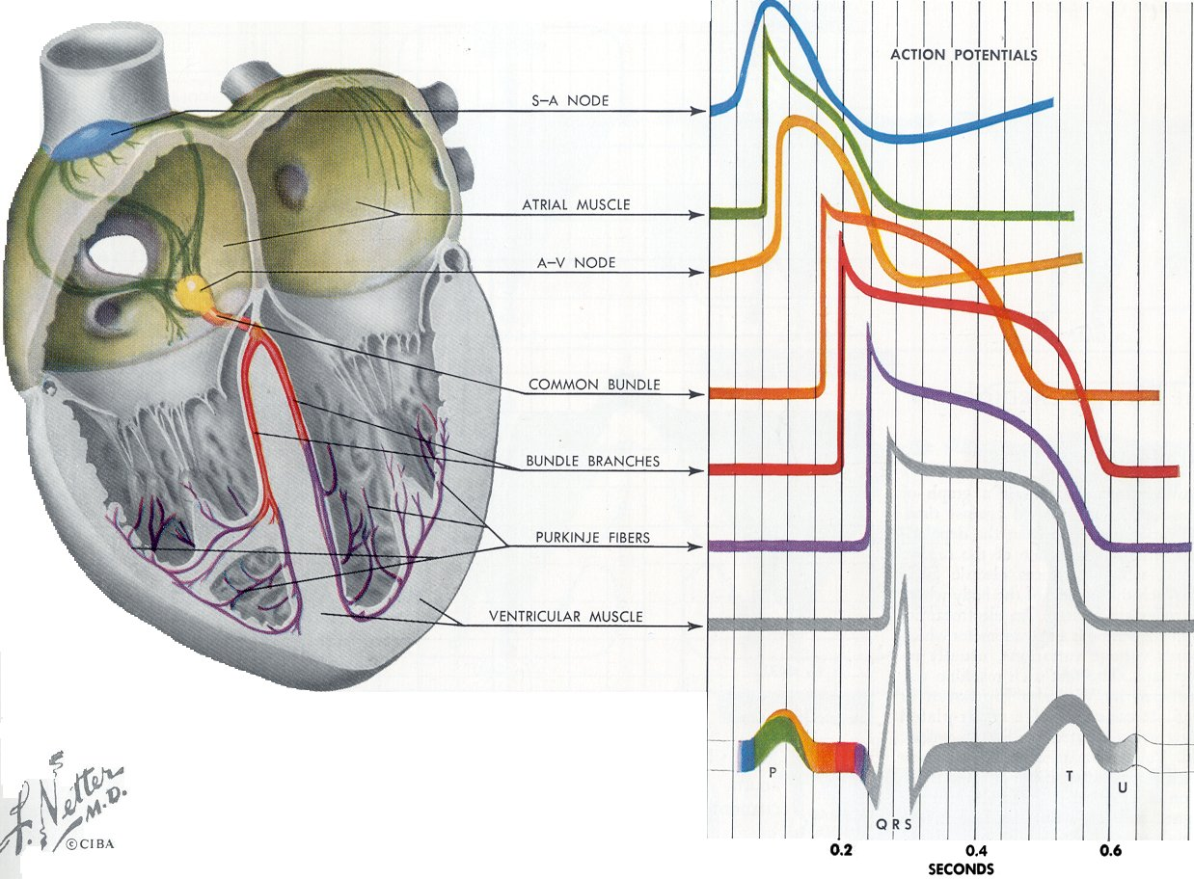
Electrocardiogram
P wave = electrical activity of the atrial muscle.
QRST waves = electrical activity of the ventricular muscle.
The ECG does NOT show activity of the conduction system (too small volume of cells).
The ECG shows changes in membrane potentials: during the plateau phase the ECG is around zero.
After more than 100 years of ECG, the origin of the U wave is still unknown!

Slide 42
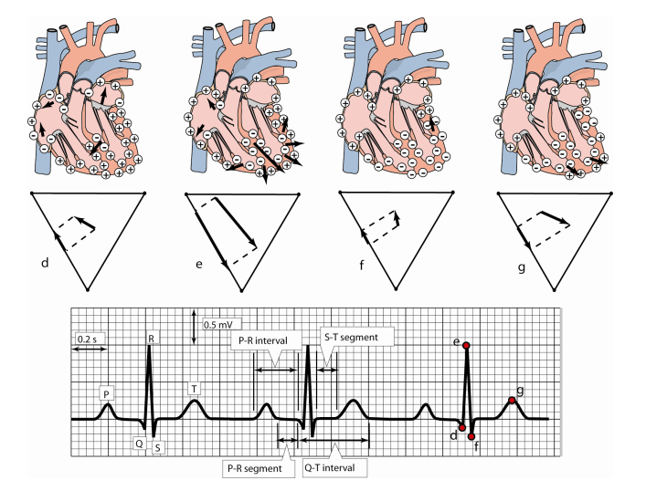
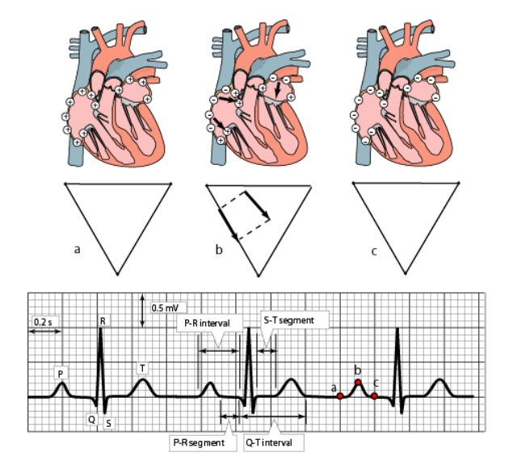
Eindhovens Triangle

Slide 43

The ECG - Terminologi
P: Atrial depolarization
Atrierne repolariserer samtidig med QRS-komplekset, og det kan derfor ikke ses
QRS: Ventricle depolarization (and atrial repolarization)
ST-segment: AP-phase
(contraction continued to expel blood)
T: Ventricle depolarization

Slide 44

Important concepts for the whole course – from Steve’s drawing which you have seen before
Conservation
Mass
Charge
Energy
Storage
Mass
Charge
Energy
Physio-chemistry
Solubility
Binding
Membrane properties
Osmolarity
Etc.
Transport
Diffusion
Convection
Active
Control
Feedforward/back
Neural
Endocrine

